Slide 1
A successful MHRN will accomplish the following tasks within the period of the award:
Extend the capacity of the network to conduct prospective trials via the successful completion of multiple pilot studies of types of interventions not yet studied across multiple network sites (e.g. pharmacotherapy, large-scale delivery of IT interventions, clinical algorithms).
Successfully complete a Signature Project of high impact on the mental health of a large population
Develop and submit at least 5 investigator-initiated applications involving outside investigators conducted within MHRN sites.
Benchmark the costs of conducting a range of studies on the network compared to historical norms, and progress toward network-involved trials to be completed with costs at an order of magnitude below prior norms.
Expand tools to create efficiency in the conduct of effectiveness and services research studies on the network.
Successfully disseminate results to health system partners resulting in change of policy and/or practice.

Slide 2
A successful MHRN will accomplish the following tasks within the period of the award:
Extend the capacity of the network to conduct prospective trials via the successful completion of multiple pilot studies of types of interventions not yet studied across multiple network sites (e.g. pharmacotherapy, large-scale delivery of IT interventions, clinical algorithms).
  Existing Pharmacotherapy – Various attempts to find funding for research on personalizing depression treatment. We’ll keep trying!
  New Pharmacotherapy – Discussing pragmatic trial of ketamine-class drug to prevent suicide attempt

Slide 3
A successful MHRN will accomplish the following tasks within the period of the award:
Successfully complete a Signature Project of high impact on the mental health of a large population

Slide 4
A successful MHRN will accomplish the following tasks within the period of the award:
Develop and submit at least 5 investigator-initiated applications involving outside investigators conducted within MHRN sites.
Dimidjian (Univ. of Colorado) – MBCT to prevent depression relapse
Shaw (Southcentral Foundation) – Identifying suicide risk in Alaskan natives
Beidas (Univ. of Pennsylvania) – Addressing lethal means in pediatric primary care
Liu (Univ. of Washington) – Advanced analytics for adaptive monitoring intervals
Stephens/Arean (Univ. of Washington) – Assessing quality of psychotherapy
Scherrer (St. Louis Univ.) – Depression in Type 2 Diabetes
Goulding (Northwestern Univ.) – Smartphone app for people with bipolar I
Gilmer (UCSD) – Treatment patterns in youth with new onset psychosis
Jacobson-Frey (University of Maryland) – Recognizing and Responding to Suicide Risk
Carson (Cambridge Health Alliance) - Suicide Prevention Among Hospitalized Adolescents Using Machine Learning and Gatekeeper Follow-Up
Scherrer (St. Louis University) - Prescription Opioid Analgesics and Risk of Major Depression
Scherrer (St. Louis University) - Pathways from Chronic Prescription Opioid Use to New Onset Mood Disorder
O’Connor (University of Louisville) – Teachable Moments Brief Intervention for Suicide Attempt Survivors
Arean / Bauer (U of Washington) - Stepped Internet-Based vs In-Person Psychotherapy for Mild to Moderate Depression
Moran (Westat) - National Suicide Prevention Evaluation
Walsh (Vanderbilt) – Risk Factors of Suicidal Ideation to Action

Slide 5
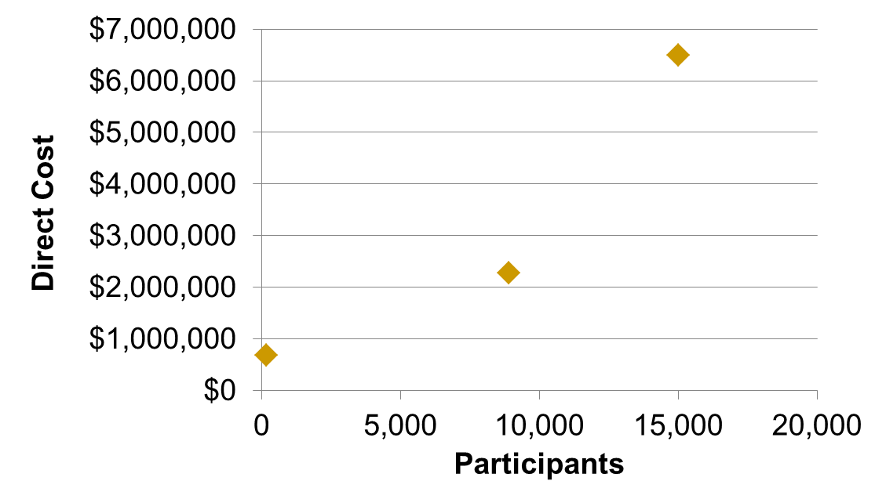
A successful MHRN will accomplish the following tasks within the period of the award:
Benchmark the costs of conducting a range of studies on the network compared to historical norms, and progress toward network-involved trials to be completed with costs at an order of magnitude below prior norms.
SPOT
$433/participant
CV Wizard
$256/participant
AIM
$4197/participant

Slide 6
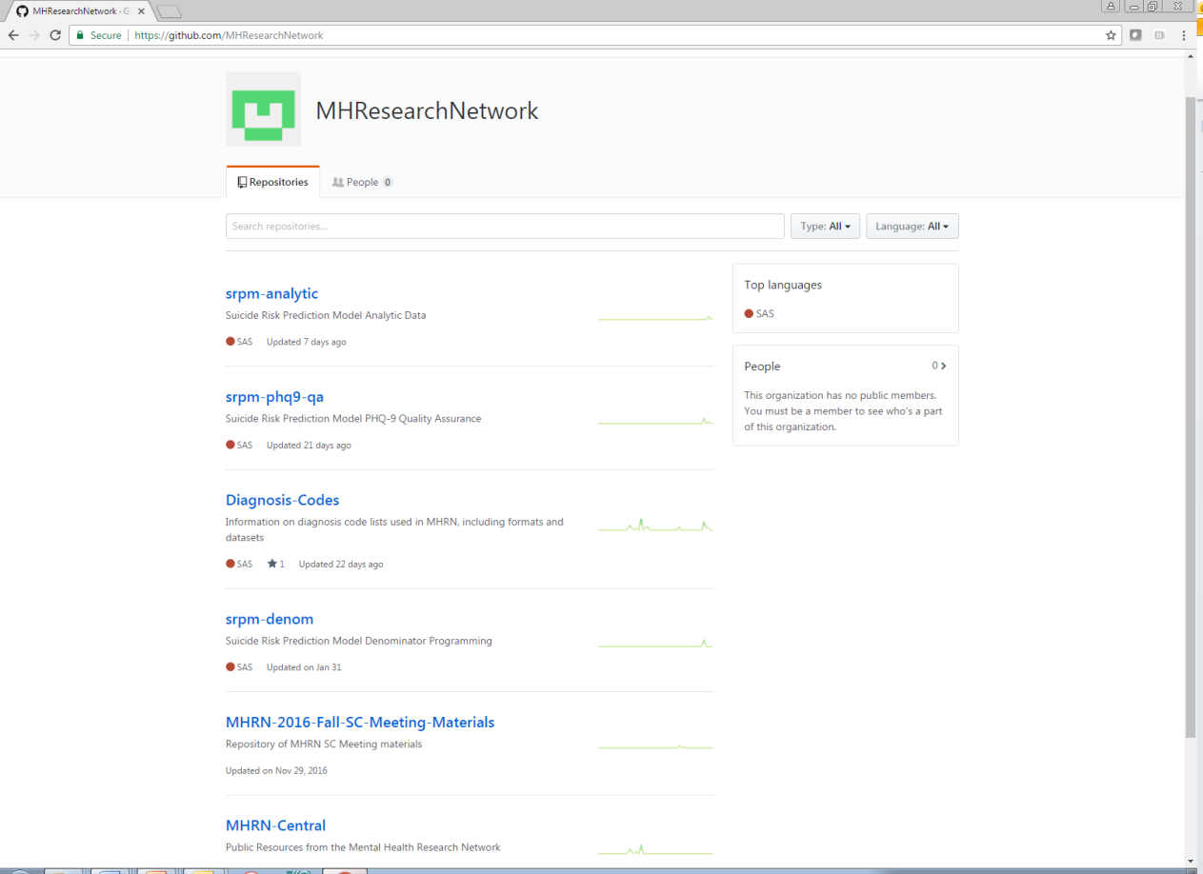
A successful MHRN will accomplish the following tasks within the period of the award:
Expand tools to create efficiency in the conduct of effectiveness and services research studies on the network.

Slide 7
A successful MHRN will accomplish the following tasks within the period of the award:
Successfully disseminate results to health system partners resulting in change of policy and/or practice.
Support for practice change
Standard work for risk assessment and safety plans
Risk Calculator to improve risk stratification
Formal evaluation of Zero Suicide implementation
Response to PHQ item 9 predicts suicide risk
Effectiveness research
Pragmatic trial of outreach programs to prevent suicide attempt
Pilot study of means restriction counseling in pediatric primary care
Exploratory research
Changes in suicidal ideation and changes in subsequent risk
Unexpected suicide attempts

